Slide 1
Time Zones

Slide 2
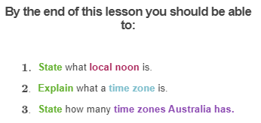

Slide 3
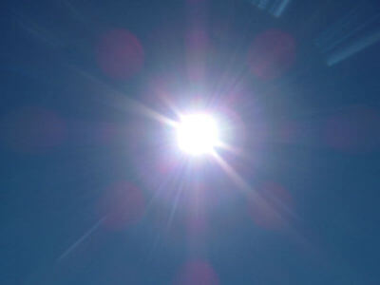
Solar noon and Local noon
When the Sun is at the highest point in the sky it is called the solar noon. Local noon is when solar noon (12 pm) occurs in a local area of the Earth.
Since Australia is so large, not everywhere in Australia has the same local noon.

Slide 4
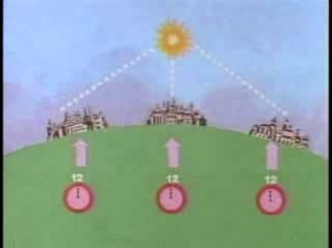

Slide 5
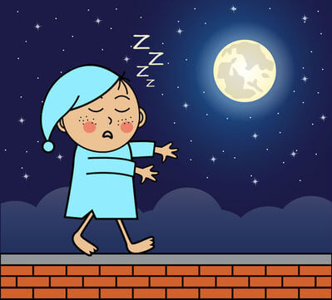
Why do we need time zones?
We need time zones so that each area of the Earth experiences noon when the Sun is directly overhead, i.e. in the middle of the day.
If noon was at the same time everywhere on Earth, some parts of the Earth would experience "noon" during the middle of the night!

Slide 6
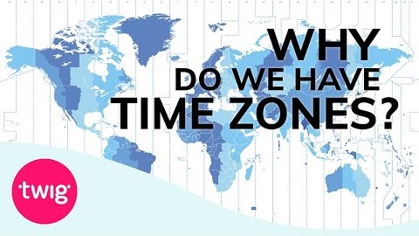

Slide 7
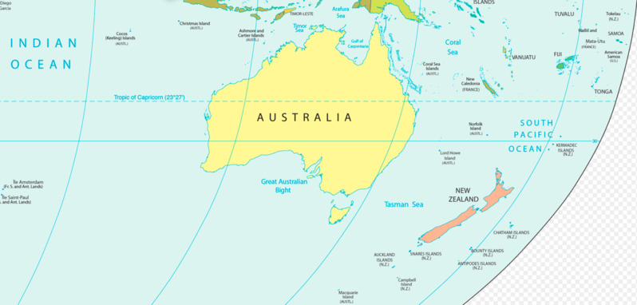
Local Noon in Australia
Australia is very large. The Sun rises in the east, which means that the local noon on the East Coast is much earlier than the local noon in Central Australia or on the West Coast.

Slide 8
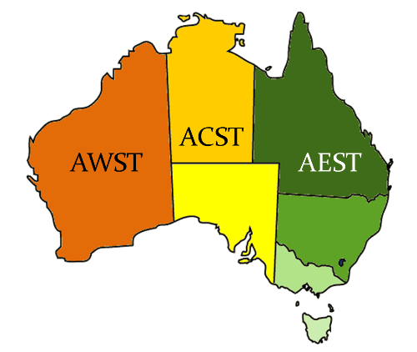
Australia has three main time zones.
Australian Eastern Standard Time (AEST) is used in Queensland, New South Wales, Victoria, Tasmania and Australian Capital Territory.
Australian Central Standard Time (ACST) is used in South Australia and Northern Territory. Australian Western Standard Time (AWST) is used in Western Australia.

Slide 9
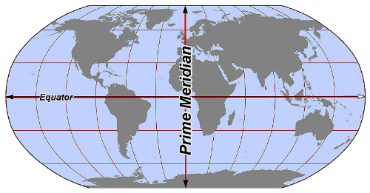
Coordinated Universal Time (UTC) is the time standard by which the whole world regulates its time.
UTC keeps time in sync with the Earth's rotation, so that local noon occurs when the Sun is at its highest point. UTC is the time that occurs along the line of longitude at 0°, which is called the Prime Meridian.

Slide 10
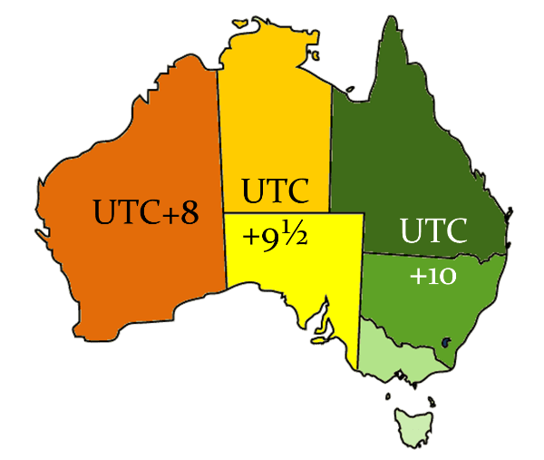
All time zones are determined relative to Coordinated Universal Time.
For example, Australian Western Standard Time is 8 hours ahead of UTC, so it is written as UTC+8. If it was midnight at the Prime Meridian, it would be 8am in Western Australia. ACST is 9.5 hours ahead of UTC (UTC+9.5) and AEST is 10 hours ahead of UTC (UTC+10).

Slide 11
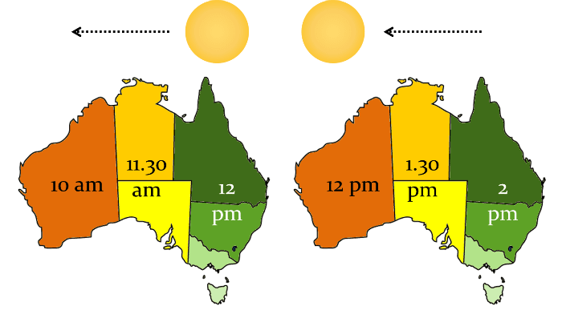
The East Coast of Australia sees the sun first, so it also experiences noon first.
During winter, ACST is 30 minutes behind AEST; and AWST is 2 hours behind AEST. This means that when it is noon in the places using AEST, it is 11.30 am in the places using ACST, and 10 am in the places using AWST.

Slide 12
Daylight Savings
If you live in Australian Capital Territory, New South Wales, South Australia, Tasmania or Victoria, you will know that in spring you turn your clocks forward one hour.
This practice is called daylight saving. But how and why are we trying to save daylight?

Slide 13

Daylight saving time (DST) is used so that we can make the best use of daylight.
Moving the clocks forward one hour essentially moves one hour of daylight from the morning to the evening! This means that in summer we have more daylight in the evenings to use for outside activities.

Slide 14
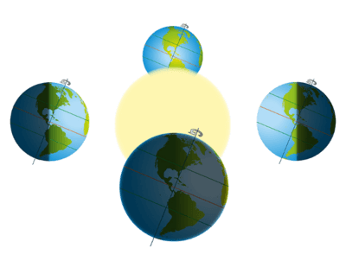
Places further from the equator experience larger differences in the number of daylight hours they get between summer and winter.
This is because of the way the Earth is tilted on its axis!

Slide 15
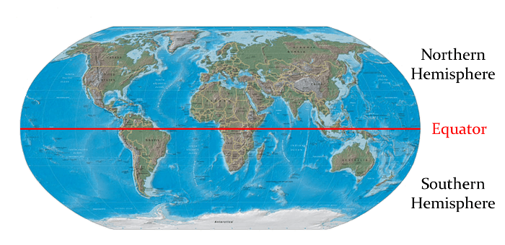
For example, Darwin, which is close to the equator, has 11 hours 23 mins of daylight on the winter solstice and 12 hours 51 minutes of daylight on the summer solstice.
Hobart, which is further away from the equator, has just 9 hours 1 minute of daylight on the winter solstice and 15 hours 21 minutes of daylight on the summer solstice.

Slide 16
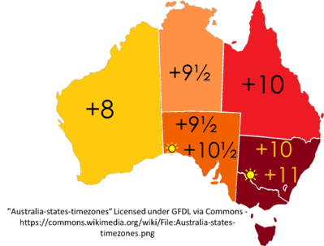
This is why only the more southern states observe daylight saving - the states closer to the equator have no need to "save daylight"!

Slide 17
In summer, Australia has five different time zones. WA, NT and QLD stay on the same time as in winter.
SA moves clocks forward one hour, so they are one hour ahead of NT and half an hour ahead of QLD.
NSW, VIC, ACT and TAS also move their clocks forward one hour, so they are one hour ahead of QLD and half an hour ahead of SA. Confused?

Slide 18
Check out the diagram below to help you.

Slide 19
